Slide 1
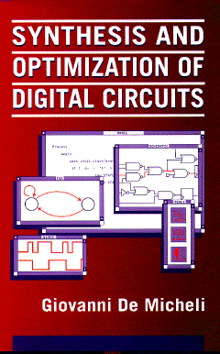


Boolean Methods for Multi-level Logic Synthesis
Giovanni De Micheli
Integrated Systems Centre
EPF Lausanne
This presentation can be used for non-commercial purposes as long as this note and the copyright footers are not removed
© Giovanni De Micheli – All rights reserved

Slide 2
Module 1
Objectives
  What are Boolean methods
  How to compute don’t care conditions
    Controllability
    Observability
  Boolean transformations

Slide 3
Boolean methods
Exploit Boolean properties of logic functions
Use don’t care conditions
More complex algorithms
  Potentially better solutions
  Harder to reverse the transformations
Used within most synthesis tools

Slide 4
External don’t care conditions
Controllability don’t care set CDC_{in}
  Input patterns never produced by the environment at the network’s input
Observability don’t care set ODC_{out}
  Input patterns representing conditions when an output is not observed by the environment
  Relative to each output
  Vector notation

Slide 5
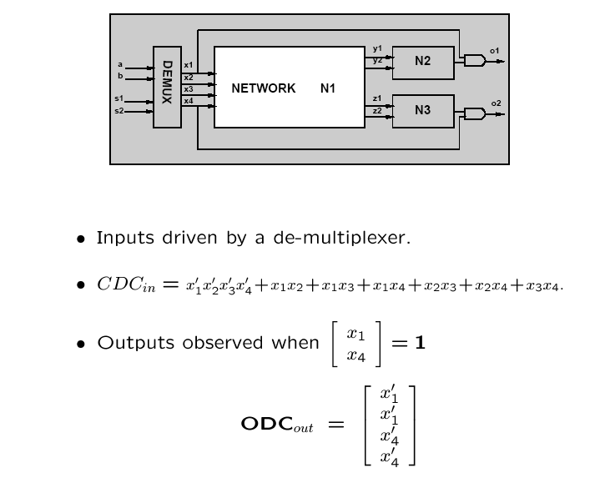
Example

Slide 6
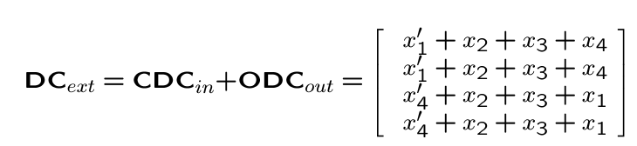
Overall external don’t care set
Sum the controllability don’t cares to each entry of the observability don’t care set vector

Slide 7
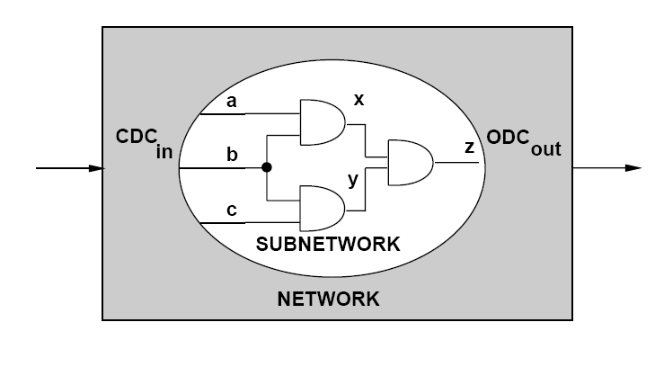
Internal don’t care conditions

Slide 8
Internal don’t care conditions
Induced by the network structure
Controllability don’t care conditions:
  Patterns never produced at the inputs of a sub-network
Observability don’t care conditions
  Patterns such that the outputs of a sub-network are not observed

Slide 9
Example of optimization with don’t cares
CDC of y includes ab’x + a’x’
Minimize f_{y} to obtain: g_{y} = ax + a’c
x = a’ + b
x = a’ + b
y = abx + a’cx
y = ax + a’c

Slide 10
Satisfiability don’t care conditions
Invariant of the network:
x = f_{x} → x ≠ f_{x} ⊆ SDC
SDC = ∑_{all internal nodes} x ⊕ f_{x}
Useful to compute controllability don't cares

Slide 11
CDC Computation
Method 1: Network traversal algorithm
  Consider initial CDC = CDC_{in} at the primary inputs
  Consider different cutsets moving through the network from inputs to outputs
  As the cutset moves forward
    Consider SDC contribution of the newly considered block
    Remove unneeded variables by consensus

Slide 12
Example
z1
z2
z1
z2
d
e
d
e
{d,e}
{b,c}
b
c
b
c
a
a
{b,a,x4}
{x1,a,x4}
{x1,x2,x3,x4}
x1
x2
x3
x4
x1
x2
x3
x4

Slide 13
Example
Assume CDC_{in} = x₁’x₄’
Select vertex v_{a}
  Contribution of v_{a} to CDC_{cut}= a ⊕ (x₂ ⊕ x₃)
  Updated CDC_{cut}= x’₁ x’₄ + a ⊕ (x₂ ⊕ x₃)
  Drop variables D = {x₂, x₃} by consensus:
  CDC_{cut} = x₁’x₄’
Select vertex v_{b}
  Contribution to CDC_{cut}: b ⊕ (x₁ + a).
    Updated CDC_{cut} = x₁’x₄’ + b ⊕ (x₁ + a)
  Drop variables x₁ by consensus:
    CDC_{cut} = b’x₄’ + b’a
…
CDC_{out} = e’ = z₂’
z1
z2
d
e
{d,e}
{b,c}
b
c
a
{b,a,x4}
{x1,a,x4}
{x1,x2,x3,x4}
x1
x2
x3
x4

Slide 14
CDC Computation
CONTROLLABILITY(G_{n}(V,E) , CDC_{in}) {
  C = V^{I};
  CDC_{cut} = CDC_{in};
  foreach vertex v_{x} ∈ V in topological order {
    C = C U v_{x};
    CDC_{cut} = CDC_{cut} + f_{x} ⊕ x;
    D = {v ∈ C s.t. all direct successors of v are in C}
    foreach vertex v_{y} ∈ D
      CDC_{cut} = C_{y}(CDC_{cut});
    C = C – D;
  };
  CDC_{out} = CDC_{cut};
}

Slide 15
CDC Computation
Method 2: range or image computation
Consider the function f expressing the behavior of the
cutset variables in terms of primary inputs
CDC_{cut} is the complement of the range of f when CDC_{in} = 0
CDC_{cut} is the complement of the image of (CDC_{in})’ under f
The range and image can be computed recursively
  Terminal case: scalar function
  The range of y = f( x ) is y + y’ (any value)
  unless f ( or f’ ) is a tautology and the range is y ( or y’ )

Slide 16
Example
range(f) = d range((b+c)|_{d=bc=1}) + d’ range((b+c)|_{d=bc=0})
When d = 1, then bc = 1 → b + c = 1 is TAUTOLOGY
If I choose 1 as top entry in output vector:
  the bottom entry is also 1.
When d = 0, then bc = 0 → b+c = {0,1}
If I choose 0 as top entry in output vector:
  The bottom entry can be either 0 or 1.
range(f) = de + d’(e + e’) = de + d’ = d’ + e
b
c
d
0 0 1
1
?
1
1
→
b
c
e
0 1 1

Slide 17
Example
z1
z2
d
e
b
c
a
x1
x2
x3
x4
f¹
f²
(x₁ + a)(x₄ + a)
(x₁ + a) + (x₄ + a)
x₁x₄ + a
x₁ + x₄ + a
f =
=
=

Slide 18
Example
  range(f) = d range(f²|(x₁x₄ + a)=1) + d’ range(f²|(x₁x₄ + a)=0)
  = d range(x₁ + x₄ + a|(x₁x₄ + a)=1) + d’ range(x₁ + x₄ + a|(x₁x₄ + a)=0)
  = d range(1) + d’ range(a’(x₁ ⊕ x₄))
  = de + d’(e + e’)
  = e + d’
CDC_{out} = (e + d’)’ = de’ = z₁z₂’
c
b
a
f₂
f₁
f’₁

Slide 19
Example
z1
z2
CDC_{in} = x’₁ x’₄
d
e
b
c
a
x1
x2
x3
x4
f¹
f²
(x₁ + a)(x₄ + a)
(x₁ + a) + (x₄ + a)
x₁x₄ + a
x₁ + x₄ + a
f =
=
=

Slide 20
Example
  image(f) = d image(f²|(x₁x₄ + a)=1) + d’ image(f²|(x₁x₄ + a)=0)
  = d image(x₁ + x₄ + a|(x₁x₄ + a)=1) + d’ image(x₁ + x₄ + a|(x₁x₄ + a)=0)
  = d image(1) + d’ image(1)
  = de + d’e
  = e
CDC_{out} = e’ = z₂’
c
b
a
f₂
f₁
f’₁

Slide 21
Observability analysis
Complementary to controllability
  Analyze network from outputs to inputs
More complex because network has several outputs
and observability depends on output
Observability may be understood in terms of perturbations
  If you flip the polarity of a signal at net x, and there is no change in the outputs, then x is not observable

Slide 22
Observability analysis
Complementary to controllability
  Analyze network from outputs to inputs
More complex because network has several outputs
and controllability depends on output
Observability may be understood in terms of perturbations
  If you flip the polarity of a signal at net x, and there is no change in the outputs, then x is not observable
  Perturbed function f_{x} ⊕ δ
  Perturbed terminal behavior f^{x} ( δ )

Slide 23
Observability don’t care conditions
Conditions under which a change in polarity of a signal x is not perceived at the output
If there is an explicit representation of the function,
the ODC is the complement of the Boolean difference ODC = ( ∂f / ∂x)’
Often, the terminal behavior is described implicitly
  Applying chain rule to Boolean difference is computationally hard

Slide 24
Tree-network traversal
Consider network from outputs to input
At root
  ODC_{out} is given
  It may be empty
At internal nodes:
  Local function y = f_{y}(x)
  ODC_{x} = (∂f_{y} / ∂x )’ + ODC_{y}
Observability don’t care set has two components:
  Observability of the local function and observability of the network beyond the local block

Slide 25
Example
  e = b + c
  b = x₁ + a₁
  c = x₄ + a₂
Assume ODC_{out} = ODC_{e} = 0
ODC_{b} = (∂f_{e}/∂b)’ = (b + c)|_{b = 1} ⊕ (b + c)|_{b = 0} = c
ODC_{c} = (∂f_{e}/∂c)’ = b
ODCx₁ = ODC_{b} + (∂f_{b}/∂x₁)’ = c + a₁
e
b
c
x1
a1
a2
x4

Slide 26
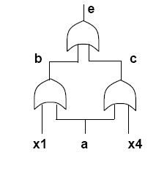
Non-tree network traversal
General networks have forks and fanout reconvergence
For each fork point, the contribution to the ODC depends on both paths
Network traversal cannot be applied in a straightforward way
More elaborate analysis is needed

Slide 27
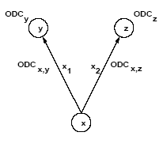
Two-way fork
Compute ODC sets associated with edges
Recombine ODCs at fork point
Theorem:
  ODC_{x} = ODC_{x,y|x=x’} ⊕ ODC_{x,z}
  ODC_{x} = ODC_{x,z|x=x’} ⊕ ODC_{x,y}
Multi-way forks can be reduced to a sequence of two-way forks

Slide 28
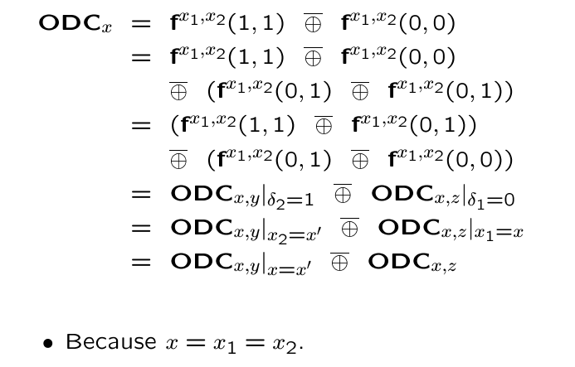
ODC formula derivation

Slide 29
Example
z1
z2
z1
z2
( )
( )
e
0
0
0
0
d
ODC_{d} =
;
ODC_{e} =
;
d
e
( )
( )
b
c
b’
b
c’
c
ODC_{c} =
;
ODC_{b} =
;
b
c
a
( )
( )
a
c’ + x₁
c + x₁
a’x₄’ + x₁
a + x₄ + x₁
ODC_{a,b} =
=
( )
( )
x1
x2
x3
x4
x1
x2
x3
x4
b’ + x₄
b + x₄
a’x₁’ + x₄
a + x₁ + x₄
ODC_{a,c} =
=
( )
( )
( )
a x₄’ + x₁
a’ + x₄ + x₁
a’x₁’ + x₄
a + x₁ + x₄
x₁x₄
x₁ + x₄
ODC_{a} =
ODC_{a,b}|_{a=a’}
⊕
ODC_{a,c}
=
⊕
=

Slide 30
Don’t care computation summary
Controllability don’t cares are derived by image computation
  Recursive algorithms and data structure are applied
Observability don’t cares are derived by backward traversal
  Exact and approximate computation
  Approximate methods compute don’t care subsets

Slide 31
Transformations with don’t cares
Boolean simplification
  Generate local DC set for local functions
  Use heuristic minimizer (e.g., Espresso)
  Minimize the number of literals
Boolean substitution:
  Simplify a function by adding one (ore more) inputs
  Equivalent to simplification with global don’t care sets

Slide 32
Example – Boolean substitution
Substitute q = a + cd into f_{h} = a + bcd + e
  Obtain f_{h} = a + bq + e
Method
  Compute SDC including q ⊕ (a+cd) = q’a +q’cd + qa’(cd)’
  Simplify f_{h} = a + bcd + e with DC = q’a + q’cd + qa’ (cd)’
  Obtain f_{h} = a + bq +e
Result
  Simplified function has one fewer literal by changing the support of f_{h}

Slide 33
Simplification operator
Cycle over the network blocks
  Compute local don’t care conditions
  Minimize
Issues:
  Don’t care sets change as blocks are being simplified
  Iteration may not have a fixed point
  It would be efficient to parallelize some simplifications

Slide 34
Optimization and perturbation
Minimizing a function at a block x is the replacement of a local function f_{x} with a new function g_{x}
This is equivalent to perturbing the network locally by
  δ_{x} = f_{x} ⊕ g_{x}
Conditions for a feasible replacement
  Perturbation bounded by local don’t care sets
  δ_{x} included in DC_{ext} + ODC + CDC
Smaller, approximate don’t care sets can be used
  But have smaller degrees of freedom

Slide 35
Example
No external don’t care set.
Replace AND by wire: g_{x} = a
Analysis:
  δ = f_{x} ⊕ g_{x} = ab ⊕ a = ab’
  ODC_{x} = y’ = b’ + c’
  δ = ab’ ⊆ DC_{x} = b’ + c’ ⇒ feasible!
a
x
a
x
b
z
b
z
c
y
c
y

Slide 36
Parallel simplification
Parallel minimization of logic blocks is always possible when blocks are logically independent
  Partitioned network
Within a connect network, logic blocks affect each other
Doing parallel minimization is like introducing multiple perturbations
  But it is attractive for efficiency reasons
Perturbation analysis shows that degrees of freedom cannot be represented by just an upper bound on the perturbation
  Boolean relation model

Slide 37
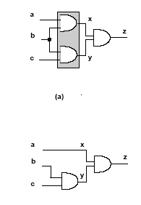
Example
Perturbations at x and y are related because of the reconvergent fanout at z
Cannot change simultaneously
  ab into a
  cb into c

Slide 38
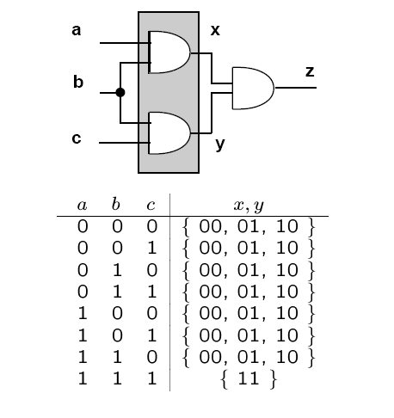
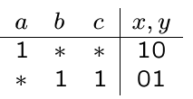
Boolean relation model

Slide 39
Boolean relation model
Boolean relation minimization is the correct approach to handle Boolean optimization at multiple vertices
Necessary steps
  Derive equivalence classes for Boolean relation
  Use relation minimizer
Practical considerations
  High computational requirement to use Boolean relations
  Use approximations instead

Slide 40
Parallel Boolean optimization compatible don’t care sets
Determine a subset of don’t care sets which is safe to use in a parallel minimization
  Remove those degrees of freedom that can lead to transformations incompatible with others effected in parallel
Using compatible don’t care sets, only upper bounds on the perturbation need to be satisfied
Faster and efficient method

Slide 41
Example
Parallel optimization at two vertices
First vertex x
  CODC equal to ODC set
  CODC_{x} = ODC_{x}
Second vertex y
  CODC is smaller than its ODC to be safe enough to allow for transformations permitted by the first ODC
  CODC_{y} = C_{x} (ODC_{y}) + ODC_{y} ODC’_{x}
Order dependence

Slide 42
Example
CODC_{y} = ODC_{y} = x’ = b’ + a’
ODC_{x} = y’ = b’ + c’
CODC_{x} = C_{y}(ODC_{x}) + ODC_{x}(ODC_{y})’
= C_{y}(y’) + y’x = y’x
= (b’ + c’)ab = abc’
a
x
b
z
c
y

Slide 43
Example (2)
Allowed perturbation:
  f_{y} = bc → g_{y} = c
  δ_{y} = bc ⊕ c = b’c ⊆ CODC_{y} = b’ + a’
Disallowed perturbation:
  f_{x} = ab → g_{x} = a.
  δ_{x} = ab ⊕ a = ab’ ⊄ CODC_{x} = abc’
a
x
b
z
c
y

Slide 44
Boolean methods
Summary
Boolean methods are powerful means to restructure networks
  Computationally intensive
Boolean methods rely heavily on don’t care computation
  Efficient methods
  Possibility to subset the don’t care sets
Boolean method often change the network substantially,
and it is hard to undo Boolean transformations

Slide 45
Module 2
Objectives
  Testability
  Relations between testability and Boolean methods

Slide 46
Testability
Generic term to mean easing the testing of a circuit
Testability in logic synthesis context
  Assume combinational circuit
  Assume single/multiple stuck-at fault
Testability is referred to as the possibility of generating test sets for all faults
  Property of the circuit
  Related to fault coverage

Slide 47
Test for stuck-ats
Net y stuck-at 0
  Input pattern that sets y to TRUE
  Observe output
  Output of faulty circuit differs from correct circuit
Net y stuck-at 1
  Input pattern that sets y to FALSE
  Observe output
  Output of faulty circuit differs from correct circuit
Testing is based on controllability and observability

Slide 48
Test sets – don’t care interpretation
Stuck-at 0 on net y
  { Input vector t such that y(t) ODC’y (t) = 1 }
Stuck-at 1 on net y
  { Input vector t such that y’(t) ODC’y (t) = 0 }

Slide 49
Using testing methods for synthesis
Redundancy removal
  Use ATPG to search for untestable fault
If stuck-at 0 on net y is untestable:
  Set y = 0
  Propagate constant
If stuck-at 1 on net y is untestable
  Set y = 1
  Propagate constant
Iterate for each untestable fault

Slide 50
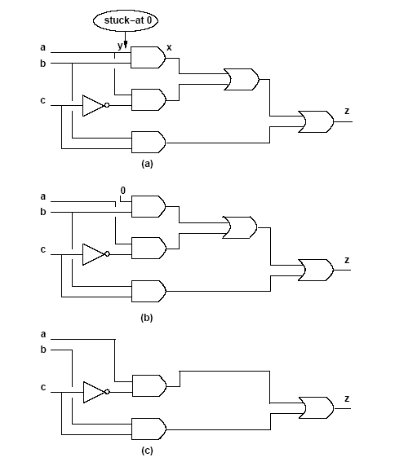
Example

Slide 51
Redundancy removal and perturbation analysis
Stuck-at 0 on y
  y set to 0. Namely g_{x} = f_{x}|_{y=0}
  Perturbation:
    δ = f_{x} ⊕ f_{x}|_{y=0} = y· ∂f_{x}/∂y
Perturbation is feasible ⇔ fault is untestable
  No input vector t can make y(t)· ODC_{y}’(t) true
  No input vector t can make y(t)· ODC_{x}’(t)· ∂f_{x}/∂y true
    Because ODC_{y} = ODC_{x} + (∂f_{x}/∂y)’
z
x
y

Slide 52
Redundancy removal and perturbation analysis
Assume untestable stuck-at 0 fault.
y· ODC_{x}’· ∂f_{x}/∂y ⊆ SDC
Local don’t care set:
  DC_{x} ⊇ ODC_{x} + y· ODC_{x}’· ∂f_{x}/∂y
  DC_{x} ⊇ ODC_{x} + y· ∂f_{x}/∂y
Perturbation δ = y· ∂f_{x}/∂y
  Included in the local don’t care set

Slide 53
Rewiring
Extension to redundancy removal
  Add connection in a circuit
  Create other redundant connections
  Remove redundant connections
Iterate procedure to reduce network
  A connection corresponds to a wire
  Rewiring modifies gates and wiring structure
  Wires may have specific costs due to distance

Slide 54
Example
a
b
c
x
c
g
m
y
h
f
d
z

Slide 55
Synthesis for testability
Synthesize fully testable circuits
  For single or multiple stuck-at faults
Realizations
  Two-level forms
  Multi-level networks
Since synthesis can modify the network properties, testability can be addressed during synthesis

Slide 56
Two-level forms
Full testability for single stuck-at faults:
  Prime and irredundant covers
Full testability for multiple stuck-at faults
  Prime and irredundant cover when
    Single output function
    No product-term sharing
    Each component is prime and irredundant

Slide 57
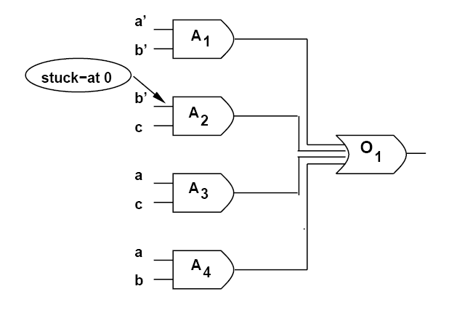
Example f = a’b’ + b’c + ac + ab

Slide 58
Multiple-level networks
Consider logic networks with local functions in sop form
Prime and irredundant network
  No literal and no implicant of any local function can be dropped
  The AND-OR implementation is fully testable for single stuck-at faults
Simultaneous prime and irredundant network
  No subsets of literals and no subsets of implicants can be dropped
  The AND-OR implementation is fully testable for multiple stuck-ats

Slide 59
Synthesis for testability
Heuristic logic minimization (e.g., Espresso) is sufficient to insure testability of two-level forms
To achieve fully testable networks, simplification has to be applied to all logic blocks with full don’t care sets
In practice, don’t care sets change as neighboring blocks are optimized
Redundancy removal is a practical way of achieving testability properties

Slide 60
Summary – Synthesis for testability
There is synergy between synthesis and testing
  Don’t care conditions play a major role in both fields
Testable network correlate to a small area implementation
Testable network do not require to slow-down the circuit
Algebraic transformations preserve multi-fault testability, and are preferable under this aspect

